Slide 1

Machine Learning and Natural Language Processing

Slide 2

Contents & Structure
Data Science
Data Analytics
Machine Learning
Natural Language Processing

Slide 3
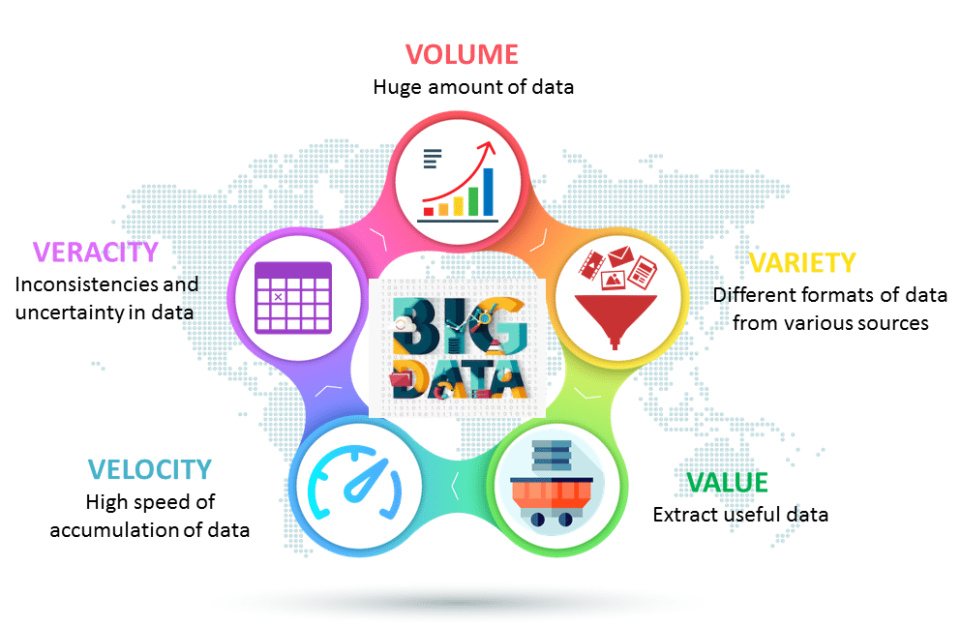
Data or Dataset
A dataset is a collection of data, usually organized in a structured format, used for analysis, training machine learning models, or gaining insights.
How Big is Your Data?
5 Vs of Big Data
Kilobyte (1000 bytes)
Megabyte (1 000 000 bytes)
Gigabyte (1 000 000 000 bytes)
Terabyte (1 000 000 000 000 bytes)
Petabyte (1 000 000 000 000 000 bytes)
Exabyte (1 000 000 000 000 000 000 bytes)
Zettabyte (1 000 000 000 000 000 000 000 bytes)
Yottabyte (1 000 000 000 000 000 000 000 000 bytes)

Slide 4

Data Science
Data science involves using automated methods to analyze massive amounts of data and to extract knowledge from them.
Data science can turn the vast amounts of data the digital age generates into new insights and new knowledge.

Slide 5
Data Analysis
Data Analysis stands for human activities aimed at gaining some insight on a dataset.
An analyst can use some Data Analytics tools to obtain desired results, but in principle, Data Analysis can be performed without special data processing.
For example: A Forex trader can rely on his/her experience to open or close a trading position.

Slide 6
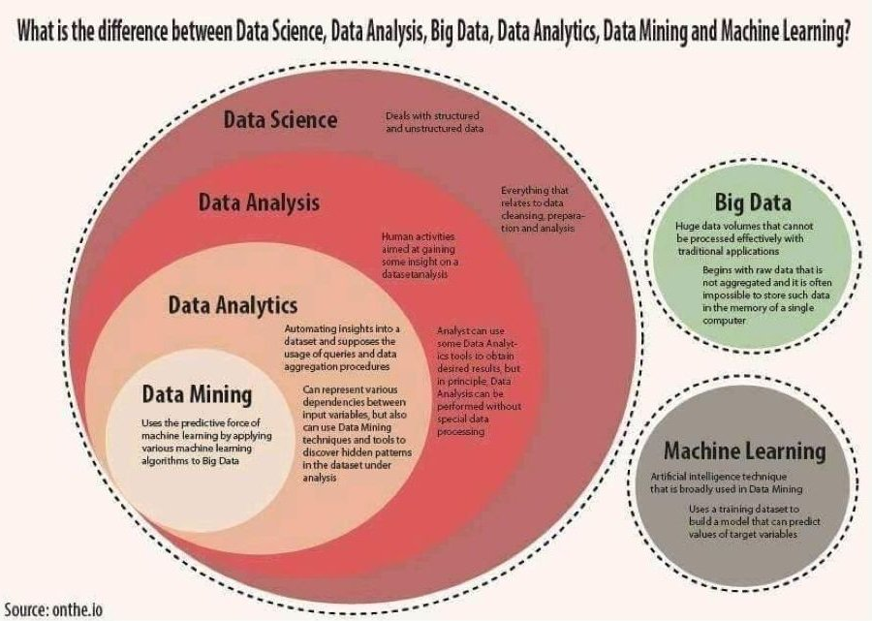
Data Analytics
Data Analytics is all about automating insights into a dataset and supposes the usage of queries and data aggregation procedures.
It can represent various dependencies between input variables, but also it can use Data Mining techniques and tools to discover hidden patterns in the dataset under analysis.
For example, not obvious associations between user purchases can be automatically discovered.

Slide 7
Data Analytics
Big Data implies huge data volumes that cannot be processed effectively with traditional applications.
Big Data processing begins with raw data that is not accumulated, and it is often impossible to store such data in the memory of a single computer.
Machine learning (ML) is an artificial intelligence technique that is broadly used in Data Mining.
ML uses a training dataset to build a model that can predict values of target variables, for example, future sales.
Data Mining uses the predictive force of machine learning by applying various machine learning algorithms to Big Data.

Slide 8

Machine Learning

Slide 9
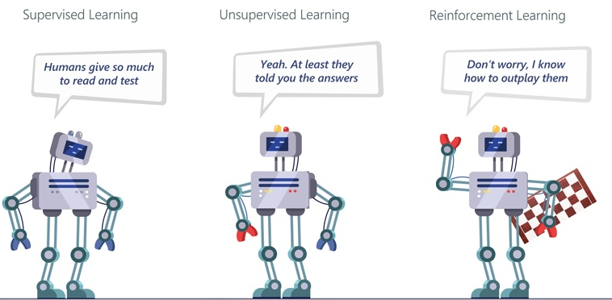
What is Machine Learning?
Not Explicitly Programmed: Enables systems to adapt and make decisions without hard-coded rules.
Learns from Data: Improves performance at a task using historical or example data.
Core Idea: Optimize a performance measure using algorithms and training data.
Interdisciplinary Field:
Statistics: Inference from data samples.
Computer Science: Efficient algorithms for optimization and model evaluation.

Slide 10
Why Machine Learning?
Machine learning is programming computers to optimize a performance criterion using example data or past experience.
Learning general models from a dataset.
Data is cheap and abundant (data warehouses, data marts); knowledge is expensive and scarce.
Build a machine learning model that is a good and useful approximation to the data.
Traditional Programming
Machine Learning
Data
Computer
Data
Computer
Output
Model
Program
Output

Slide 11
Machine Learning
To perform the tasks autonomously, machines need to learn.
For this they learn a selected model using examples (training data).
For a selected model, machines learn model parameters. This process is commonly known as “model learning”.
Machine Learning
(For a choice of Model)
Training Data
Model parameters

Slide 12
Types of Machine Learning
Supervised learning: given correct answers for each example (labelled data), learn the model to map input features to labels
e.g. learn to recognize cars by images of cars and non-cars
Unsupervised learning: discover hidden patterns in data (unlabelled data)
Group toys of a given colour or shape from a Lego set
e.g. learn to categorize stars or genomic data when no labels is given (clustering, grouping)
Reinforcement learning: occasional rewards/punishments after series of decisions
e.g. learn to play tennis / table tennis

Slide 13
Types of Machine Learning Supervised learning
Supervised Learning (also called as Predictive): Predict an unknown value(s) of a target variable(s) from the values of some input attributes.
Classification: Predict the type/class of new cases.
Spam Filtering, Handwriting Character Recognition, Patient Diagnosis.
Regression: Predict a numerical value of new cases.
Blood Pressure, Sales Amounts .
Supervised Anomaly Detection: Identify items, events or observations deviating from expected patterns using data labeled as "normal" and "abnormal" (involves training a classifier).
It is common to combine different methods such as clustering and classification (Hybrid methods).
Classification
Regression
Anomaly Detection
Supervised

Slide 14

Types of Machine Learning Supervised learning
X: Attributes (Features, Descriptors)
Labeled example / Concept
BP T A G S
y
Target Variable
: : : : :
: : : : :
: : : : :
: : : : :
: : : : :
: : : : :
: : : : :
: : : : :
H
H
NH
H
NH
NH
H
Learning “Healthy” Concept
x
y (Label)
H: Healthy
NH: Not healthy
BP: Blood pressure
T: Temperature
A: Age
G: Gender
S: Smoking
Supervisor

Slide 15

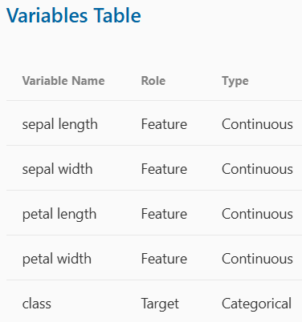
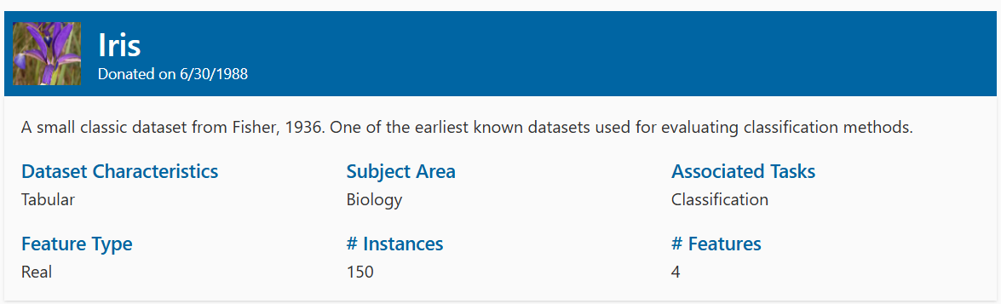
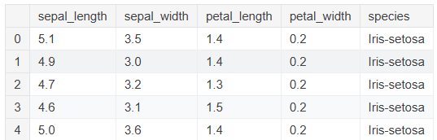
Supervised learning Classification Example
IVs
A classification model can be built to classify
the “species” based on the IVs.
TV

Slide 16

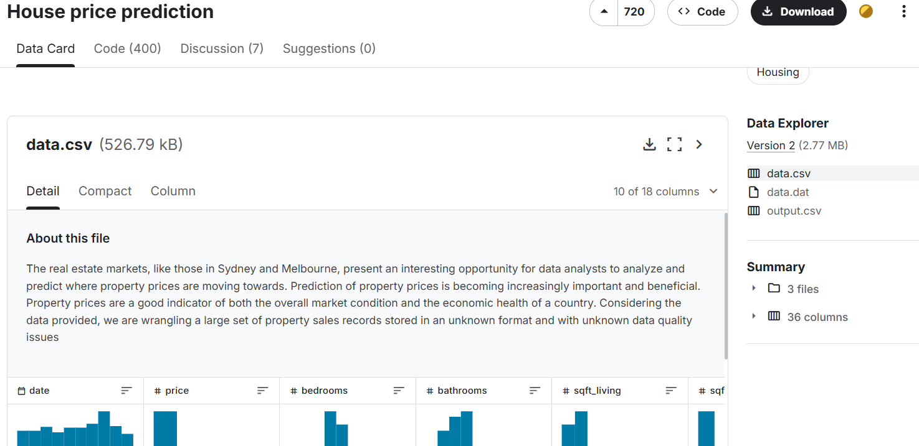
Supervised learning Regression Example
This is a house price prediction dataset
Many IVs
1 TV = Price

Slide 17
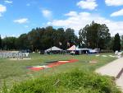




Supervised learning Image Classification
Test Image
Training Labels
(Targets)
Image Features
Training Images
Training
Image Features
Classifier Training
Trained Classifier
Prediction
Outdoor
Testing
The learning pipeline of the cat versus dog classification problem.
The same general pipeline is used for essentially all machine learning problems.
Example:

Slide 18
Types of Machine Learning Unsupervised learning
Unsupervised Learning (also called as Descriptive): Try to find meaningful patterns in the data.
Clustering: group similar data into clusters.
Market Segmentation, Document Clustering
Association Rule Discovery: find human interpretable patterns (associations)
Product Recommendations, Store Shelf Management
Sequential Pattern Discovery: describe the sequential dependencies among different events.
Buying Patterns, Gene Sequencing
Unsupervised anomaly detection: to detect anomalies in unlabeled data under the assumption that most of the instances are normal.
Fraud Detection, Network Intrusion Detection
Unsupervised
Clustering
Association Rule Discovery
Sequential Pattern Discovery
Anomaly Detection

Slide 19
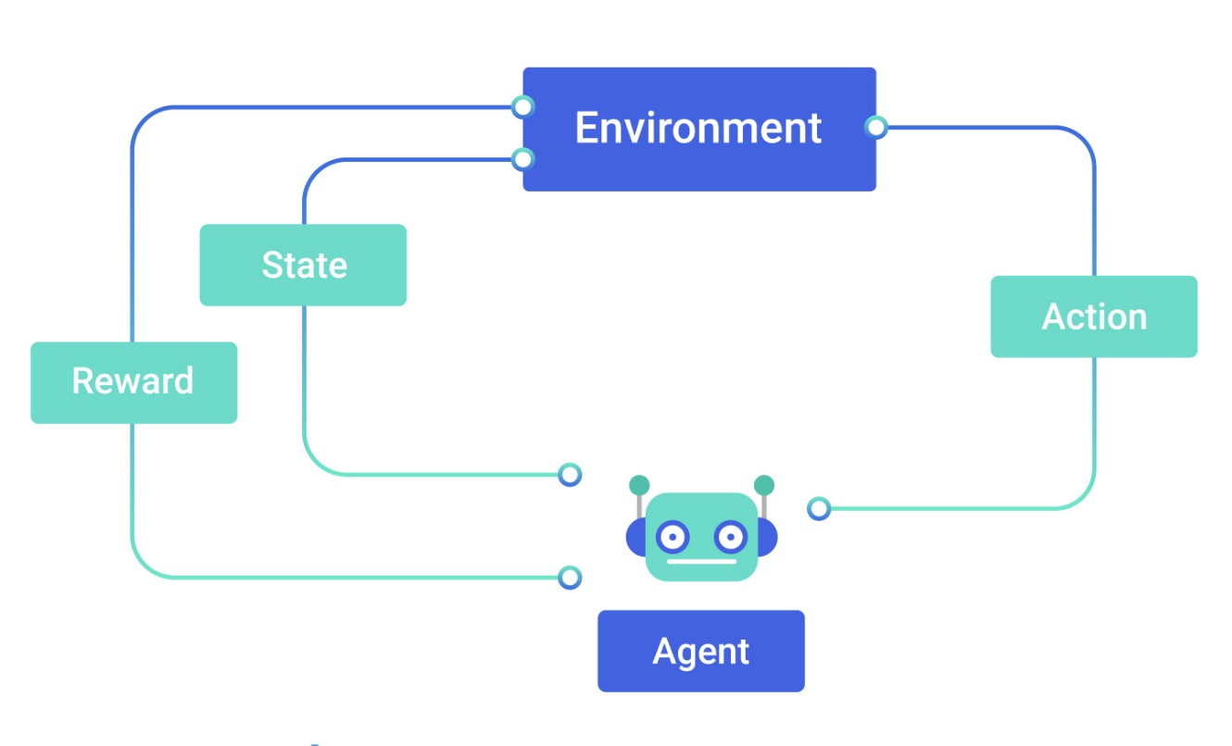
Types of Machine Learning Reinforcement learning
Reinforcement learning (RL) is an area of machine learning concerned with how software agents ought to take actions in an environment to maximize some notion of cumulative reward.

Slide 20
Some Applications
Retail: Market basket analysis, Customer relationship management (CRM)
Finance: Credit scoring, fraud detection
Manufacturing: Optimization, troubleshooting
Medicine: Medical diagnosis
Telecommunications: Quality of service optimization
Web mining: Search engines

Slide 21
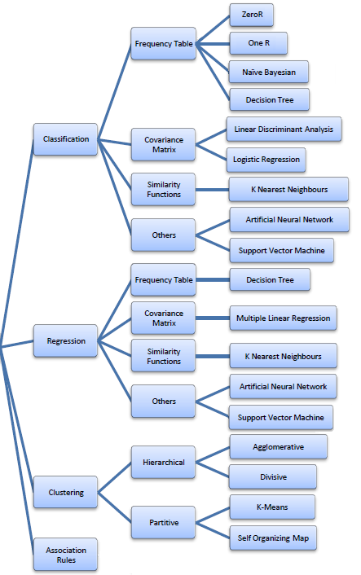

Machine Learning
Modeling
http://www.saedsayad.com/data_mining_map.htm

Slide 22
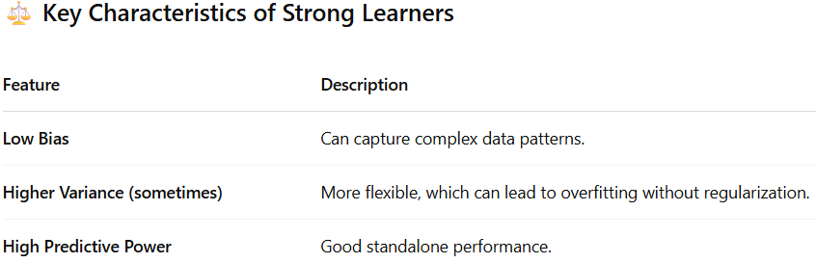
Ensemble Techniques in Machine Learning
Weak Learner:
Naive Bayes
Decision Trees
Logistic Regression
Linear SVM
KNN
Strong Learner:
Random Forest
Gradient Boosting Machines (GBM) – XGBoost | LightGBM | CatBoost
Support Vector Machines (SVM) with Nonlinear Kernels (RBF)
Neural Networks / Deep Learning – DNN | CNN | RNN

Slide 23
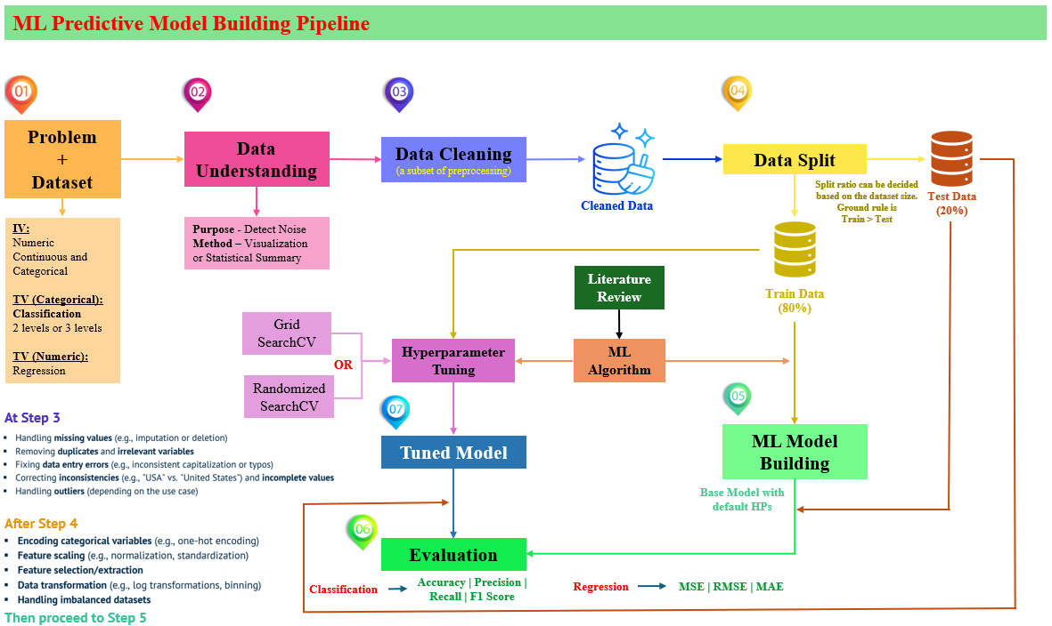
Machine Learning Model Building Pipeline
✅ After splitting data helps:
Prevent data leakage
Handle unseen categories correctly
Accurate Feature Engineering
Ensures Fair Model Evaluation
Reflects Real-World Deployment

Slide 24

Natural Language Processing

Slide 25
Natural Language Processing
Natural language processing (NLP) refers to the branch of AI concerned with giving computers the ability to understand text and spoken words as human.
NLP combines computational linguistics, rule-based modeling of human language with statistical, machine learning, and deep learning models.
NLP drives computer programs that translate text from one language to another, respond to spoken commands, and summarize large volumes of text rapidly, even in real time.
NLP also plays a growing role in enterprise solutions that help streamline business operations, increase employee productivity, and simplify mission-critical business processes.

Slide 26
Natural Language Processing
Some of the promising NLP Tasks
Speech recognition
Part of speech tagging
Word sense disambiguation
Named entity recognition
Text Classification
Sentiment analysis / Classification
Fake news / review detection
Cyberbully detection
Text Generation / Natural language generation
Image Captioning
Document Summarization

Slide 27



Natural Language Processing
NLP tools and Libraries
Natural Language Toolkit (NLTK)
Textblob
CoreNLP
spaCy
scikit-learn
Gensim
Pattern
Hugging Face transformer
koRpus
OpenNLP
Spacyr
Text2vec
Stanford CoreNLP
NLP4J
Apache OpenNLP

Slide 28
Natural Language Processing
NLP Use Cases
Natural language processing is the driving force behind machine intelligence in many modern real-world applications.
Many day-to-day NLP applications such as autocorrection, translation, or chatbots.
However, other enterprise related applications are also available.

Slide 29
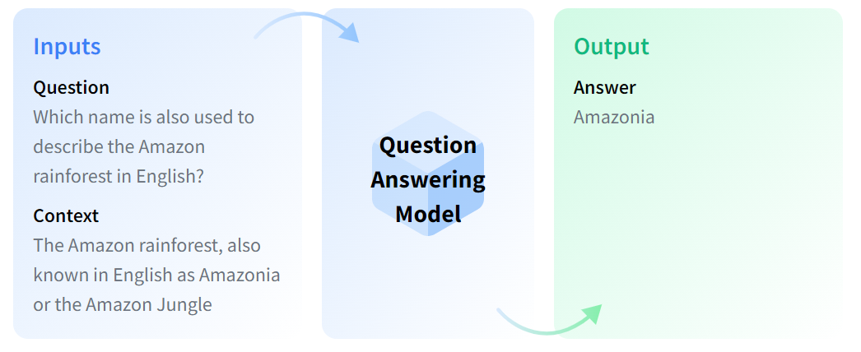
Natural Language Processing - Applications
Question Answering
A branch of artificial intelligence within the natural language processing and information retrieval fields; building systems that answer questions posed in a natural language
Question Answering (QA) models to automate the response to frequently asked questions by using a knowledge base (documents) as context.
Some question answering models can generate answers without context!
Extractive QA
Open Generative QA
Closed Generative QA
Ref: https://huggingface.co/tasks/question-answering

Slide 30
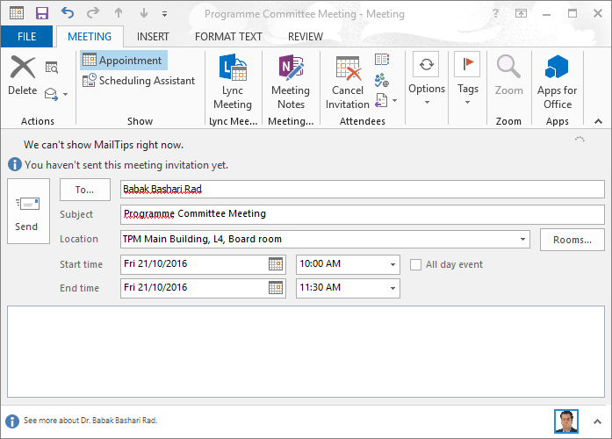
Natural Language Processing - Applications
Information Extraction
Automated retrieval of specific information related to a selected topic from a body or bodies of text.
Subject: Programme Committee Meeting
Date: October 20, 2022
To: Rad
Hi Rad, we’ve now scheduled the curriculum meeting.
It will be in TPM Main Building, L4, Board room, tomorrow from 10:00-11:30.
- Jacqueline

Slide 31


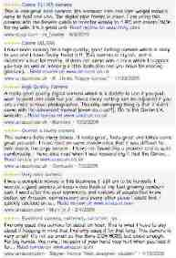
Natural Language Processing - Applications
Information Extraction & Sentiment Analysis
An approach to natural language processing (NLP) that identifies the emotional tone behind a body of text.
Attributes:
zoom
affordability
size and weight
flash
ease of use
nice and compact to carry!
since the camera is small and light, I won't need to carry around those heavy, bulky professional cameras either!
the camera feels flimsy, is plastic and very light in weight you must be very delicate in the handling of this camera

Slide 32
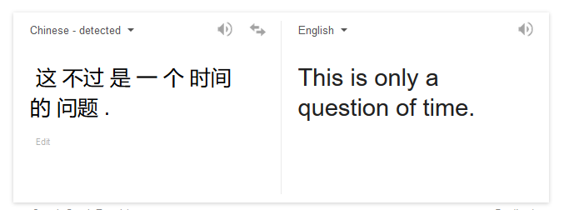
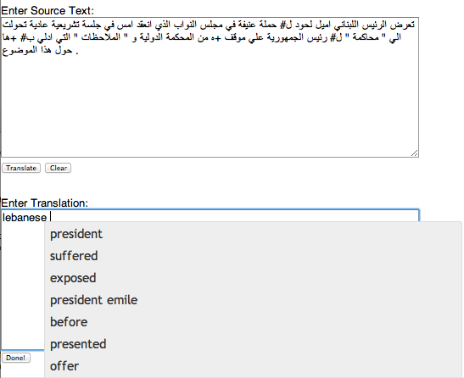
Natural Language Processing - Applications
Machine Translation
The task of automatically converting one natural language into another, preserving the meaning of the input text, and producing fluent text in the output language.
There are four types of machine translation:
Statistical Machine Translation or SMT
Uses statistical models. E.g.: Google Translate
Rule-based Machine Translation or RBMT
Translates the basics of grammatical rules.
Hybrid Machine Translation or HMT
Mix of RBMT and SMT
Neural Machine Translation or NMT
Relies upon neural network models
Fully Automatic
Helping human translators

Slide 33




Natural Language Processing - Landscape
Making good progress
Sentiment analysis
Still hard
Mostly solved
Best roast chicken in San Francisco!
Question answering (QA)
The waiter ignored us for 20 minutes.
Spam detection
Coreference resolution
Q. How effective is ibuprofen in reducing fever in patients with acute febrile illness?
✓
Let’s go to Agra!
✗
Carter told Mubarak he shouldn’t run again.
Paraphrase
Buy V1AGRA …
Word sense disambiguation (WSD)
XYZ acquired ABC yesterday
Part-of-speech (POS) tagging
I need new batteries for my mouse.
ABC has been taken over by XYZ
ADJ ADJ NOUN VERB ADV
Parsing
Summarization
Colorless green ideas sleep furiously.
The Dow Jones is up
Economy is good
I can see Alcatraz from the window!
The S&P500 jumped
Named entity recognition (NER)
Machine translation (MT)
Housing prices rose
PERSON ORG LOC
第13届上海国际电影节开幕…
Dialog
Where is Citizen Kane playing in SF?
Einstein met with UN officials in Princeton
The 13th Shanghai International Film Festival…
Information extraction (IE)
Castro Theatre at 7:30. Do you want a ticket?
You’re invited to our dinner party, Friday May 27 at 8:30
Party May 27 add

Slide 34
Natural Language Processing – Few Challenges
Ambiguity
Referred as the ability of being understood in more than one way.
Types of ambiguities
Lexical Ambiguity
The ambiguity of a single word. E.g.: treating the word silver as a noun, an adjective, or a verb.
Syntactic Ambiguity
When a sentence is parsed in different ways. E.g.: “The man saw the girl with the telescope”.
Semantic Ambiguity
When the meaning of the words themselves can be misinterpreted. E.g.: “The car hit the pole while it was moving”.
Anaphoric Ambiguity
Arises due to the use of anaphora entities in discourse. E.g.: “John persuaded Bill to buy a TV for himself”

Slide 35
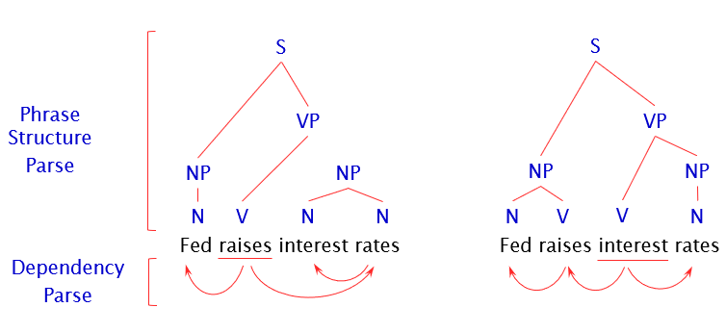
Natural Language Processing – Few Challenges
Ambiguity
Some more examples.
Ambiguity is Pervasive
Some more examples.
Violinist Linked to JAL Crash Blossoms
Teacher Strikes Idle Kids
Red Tape Holds Up New Bridges
Hospitals Are Sued by 7 Foot Doctors
Juvenile Court to Try Shooting Defendant
Local High School Dropouts Cut in Half
[Fed raises interest] rates 0.5%

Slide 36
Natural Language Processing – Other Challenges
non-standard English
neologisms
idioms
Great job @justinbieber! Were SOO PROUD of what youve accomplished! U taught us 2 #neversaynever & you yourself should never give up either♥
unfriend
Retweet
bromance
dark horse
get cold feet
lose face
throw in the towel
segmentation issues
world knowledge
tricky entity names
Mary and Sue are sisters.
Mary and Sue are mothers.
Where is A Bug’s Life playing …
Let It Be was recorded …
… a mutation on the for gene …
the New York-New Haven Railroad
the New York-New Haven Railroad
Neologism → a newly coined word or expression
Idioms → a group of words established by usage as having a meaning

Slide 37
What to do?
The task is difficult! What tools do we need?
Knowledge about language
Knowledge about the world
A way to combine knowledge sources
How we generally do this:
probabilistic models built from language data
P(“maison” → “house”) high
P(“L’avocat général” → “the general avocado”) low
Luckily, rough text features can often do half the job.

Slide 38



Thank You!
You can reach me at:
raheem@apu.edu.my
https://www.linkedin.com/in/mafas-raheem/

